Slide 1
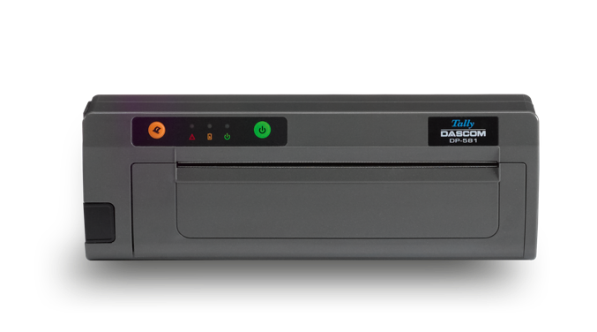
DP-581 Mobile Printer
DASCOM Europe GmbH

Slide 2
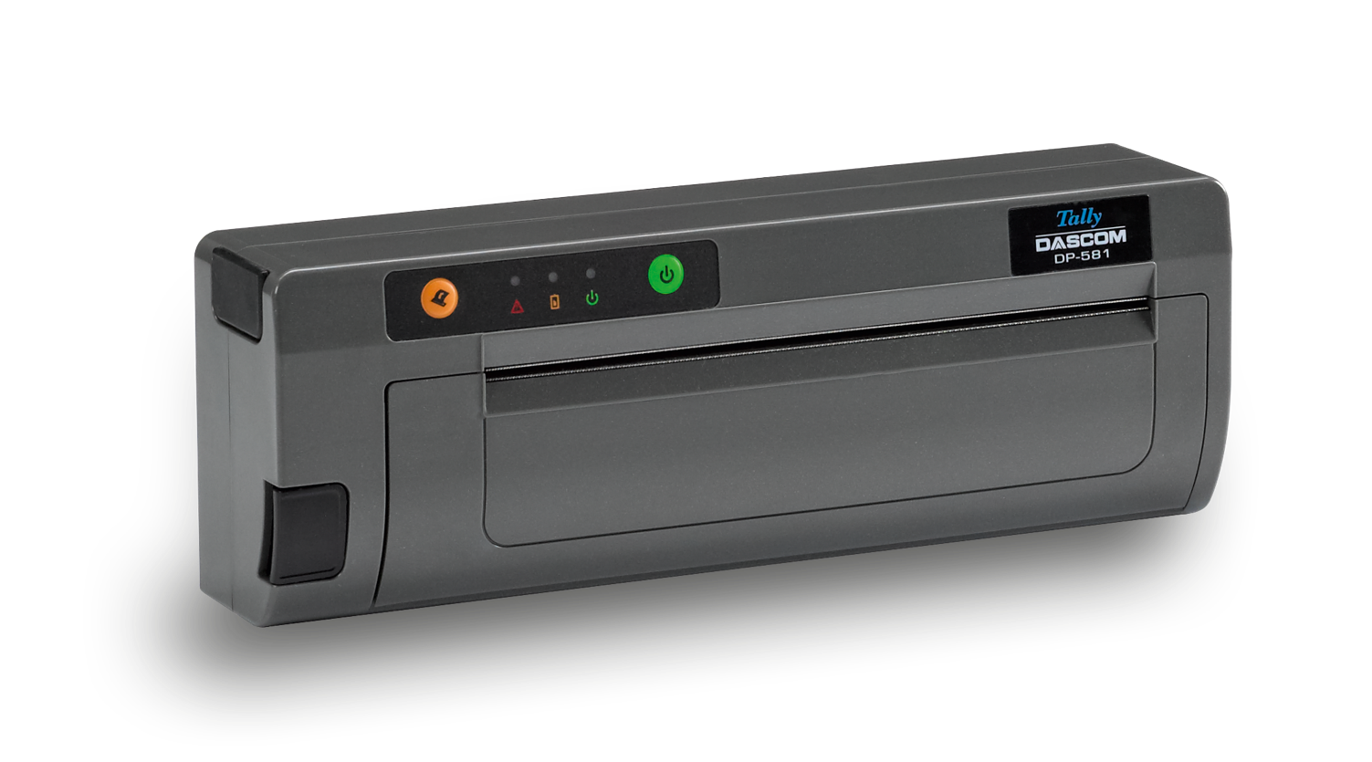
Robust, fast and reliable printer designed for direct deliveries with A4 format support
Available with USB, Bluetooth or WiFi interface
Battery version for ultra-mobile application
Mounting plate for RAM systems
Easy handling due to drop-in paper loading
Works with roll or fanfold paper as well as single sheet
Optimized for use in vehicle
Notes:
Vorlage Mobile Drucker

Slide 3
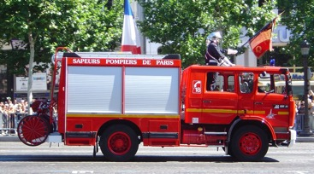
Emergency services
Police needs immediate expression of information
Investigations on specific incidents: medical, hazardous substances, checking suspects, etc.
Error messages, databases queries, maps
A fast, wide-format printer with a small footprint is desired
Typical connection is Bluetooth
Notes:
Vorlage Mobile Drucker

Slide 4
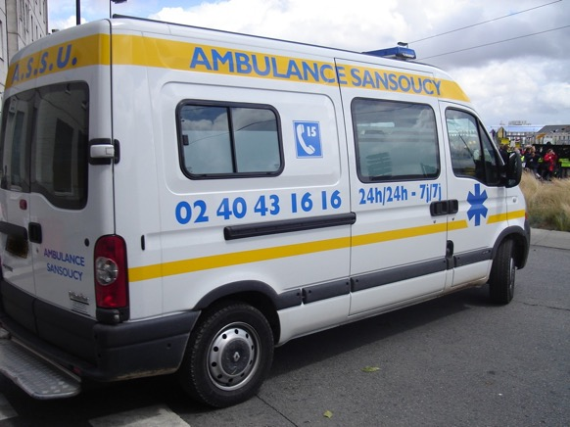
Ambulances
Data queries of medical host system
Download of medical reports
Error messages
Notes:
Vorlage Mobile Drucker

Slide 5
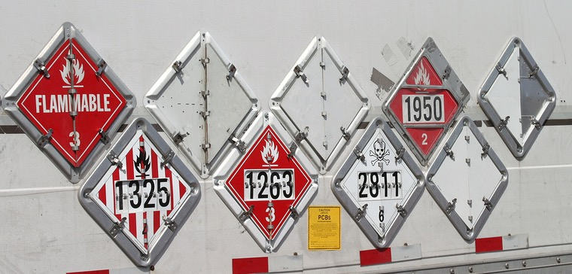
Chemical & hazardous substances
Changes on deliveries, etc.
Database queries after incidents or incidents
Notes:
Vorlage Mobile Drucker

Slide 6
Delivery notes
Food & beverage
Invoice at point of sale
A4/8” format
Host connection via Bluetooth, PDA or handheld
Connection via wired cable, Bluetooth or WiFi
Printing via Windows driver or character oriented applications
Notes:
Vorlage Mobile Drucker

Slide 7
Technical Specifications
Print speed Up to 2 inch/sec (50 mm/sec)
Resolution 203 dp (8 dots/mm)
Lifetime print head 50 km
Memory 256 kB FLASH, 512 MB DRAM
Print width Up to 216 mm
Interfaces Standard USB 2.0 (Typ C)
Interfaces Optional Bluetooth (4.0) or WiFi (802.11 b/g/n) Bluetooth Compatible Bluetooth 4.0 Stack Protocols: L2CAP, RFCOMM, SDP Profile: GAP, SDAP, SPP, BTLE WiFi Encryption: WEP, WPA-PSK/TKIP, WPA2-AES, 802.1x EAP mit TLS, TTLS, LEAP, FAST, PEAP
Notes:
Vorlage Mobile Drucker

Slide 8
Technical Specifications II
Administration Internal Website
Emulations Zebra CPCP and ZPL, EPL, ESC/POS, PostScript, Extech, IPL
Roll diameter Max. diameter 2“ (50,8 mm)
Roll capacity Approx. 30 m (equals 100 DIN A pages)
Battery Rechargeable 6 cells Lithium-Ion (5.900 mAh) Endurance more then 300 printed pages / Charging time 5,7hours
Weight 1,6 kg (standard model); 1,95 kg (battery model)
Dimensions 305 x 64 x 107 mm (W x D x H)
Voltage 19 V; 3,4 A
Power consumption 30 Watt (printing); 1,9 Watt (stand-by)
Temperature -18 to +50 C (printing); -20 to 60 C (storage); Humidity 10% to 90%
MTBF 10.000 hours
Drivers Windows 7/8/10, Windows CE/Pocket PC, Windows Mobile, Android
Notes:
Vorlage Mobile Drucker

